Slide 1


WELCOME TO

Slide 2


Slide 3
MILITARY MANAGEMENT SYSTEM

Slide 4
MD. ALINUR HOSSAIN 20-41855-1
SUMAYA JAHAN KANTA 20-41853-1
MAHMUDUL HASAN 20-41876-1
UMA BANIA ARCHI 20-41878-1

Slide 5
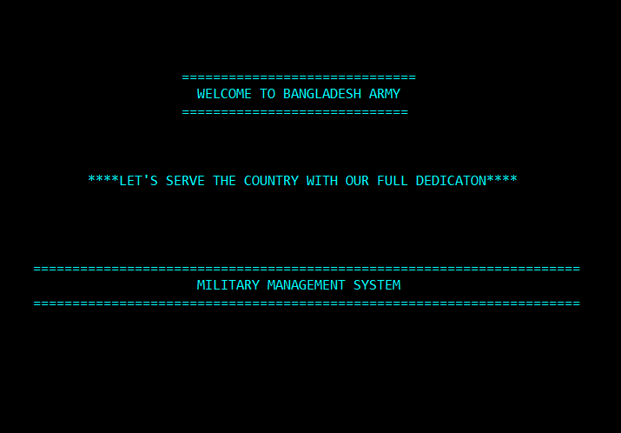
PROJECT INTRODUCTION
This project is the best solution for the Army to manage the systems which is all about Military Management System. It will save every necessary thing in an emergency combat situation. Also at a same time, one can be found and modified easily through this management system.
Hope you’ll like this project.

Slide 6
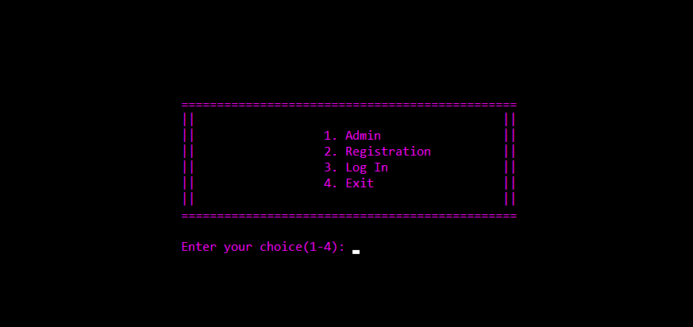
FEATURES OF THE PROJECT
This Management system has Admin Access which is highly secured. But for a soldier, first he/she needs to do registration, then he/she can log in to take some necessary things for combat.

Slide 7
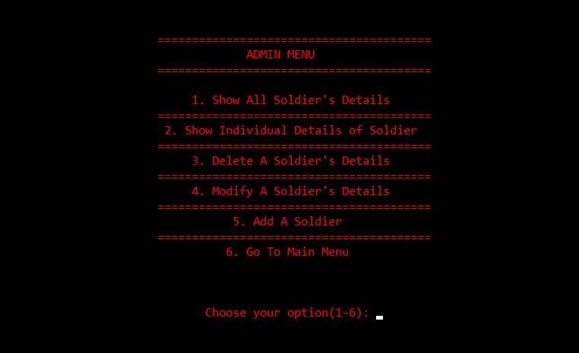
ADMIN PANEL
A very sensitive part of this project. But also it is highly secured. An admin can see everyone’s details at a time or individually. Admin can also delete or modify a soldier’s details. Also can add a soldier.
Admin just need the ID of the soldier to do this things. Not the password.

Slide 8
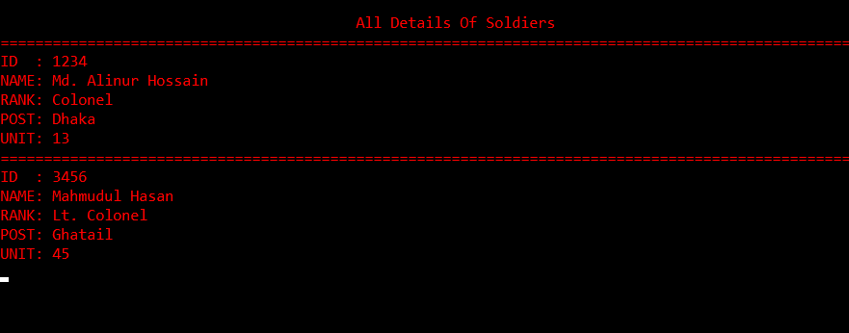
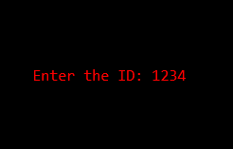
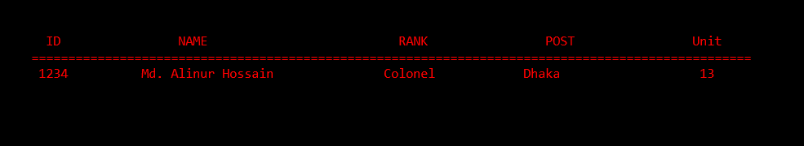
Features of admin menu
Admin Can see every soldiers details at a time
OR
By entering an ID
Admin can see individual details

Slide 9

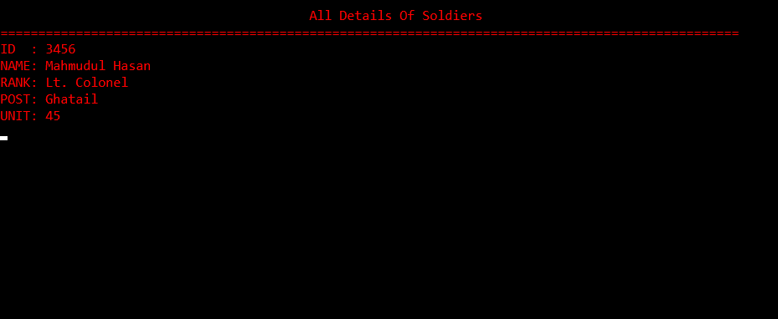
By just entering an ID
A detail can be deleted
Before
After

Slide 10
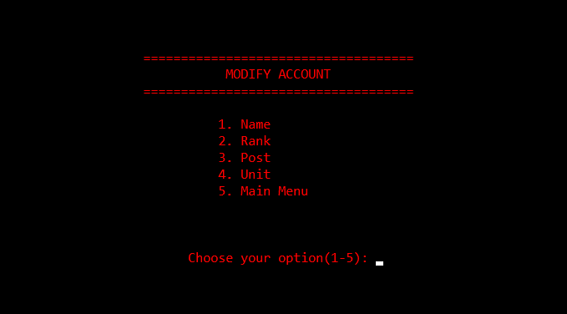
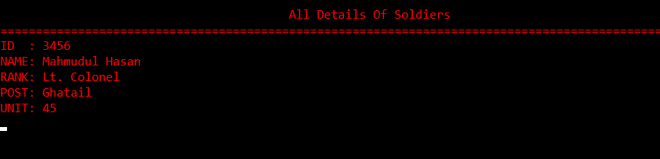
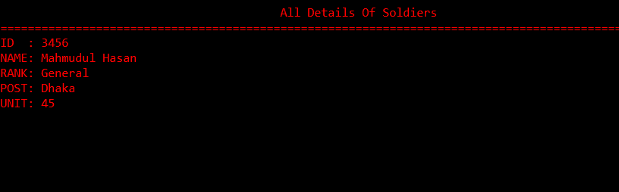
Admin can modify every single information
Before
After

Slide 11
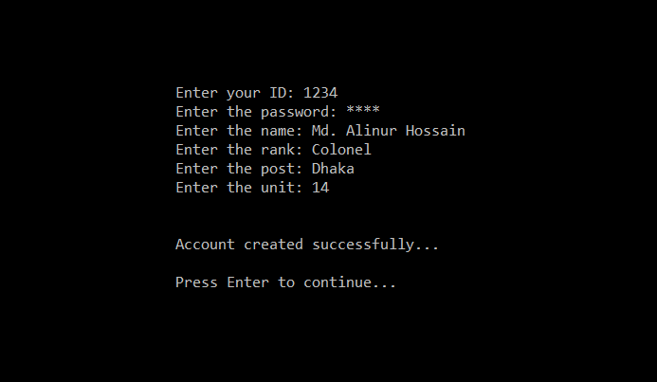
Registration process
A soldier can register here to gain
access to the soldier’s menu after login

Slide 12
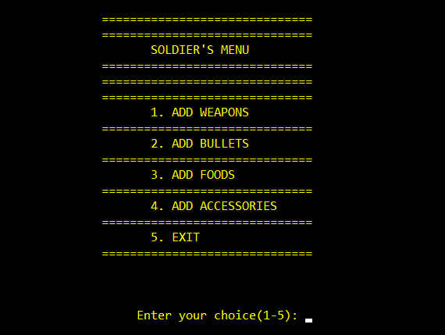
Features of log in
After logging in, a soldier can take his/her
essential things to get ready for the combat situation….

Slide 13
T h a n k y o u

